Slide 1
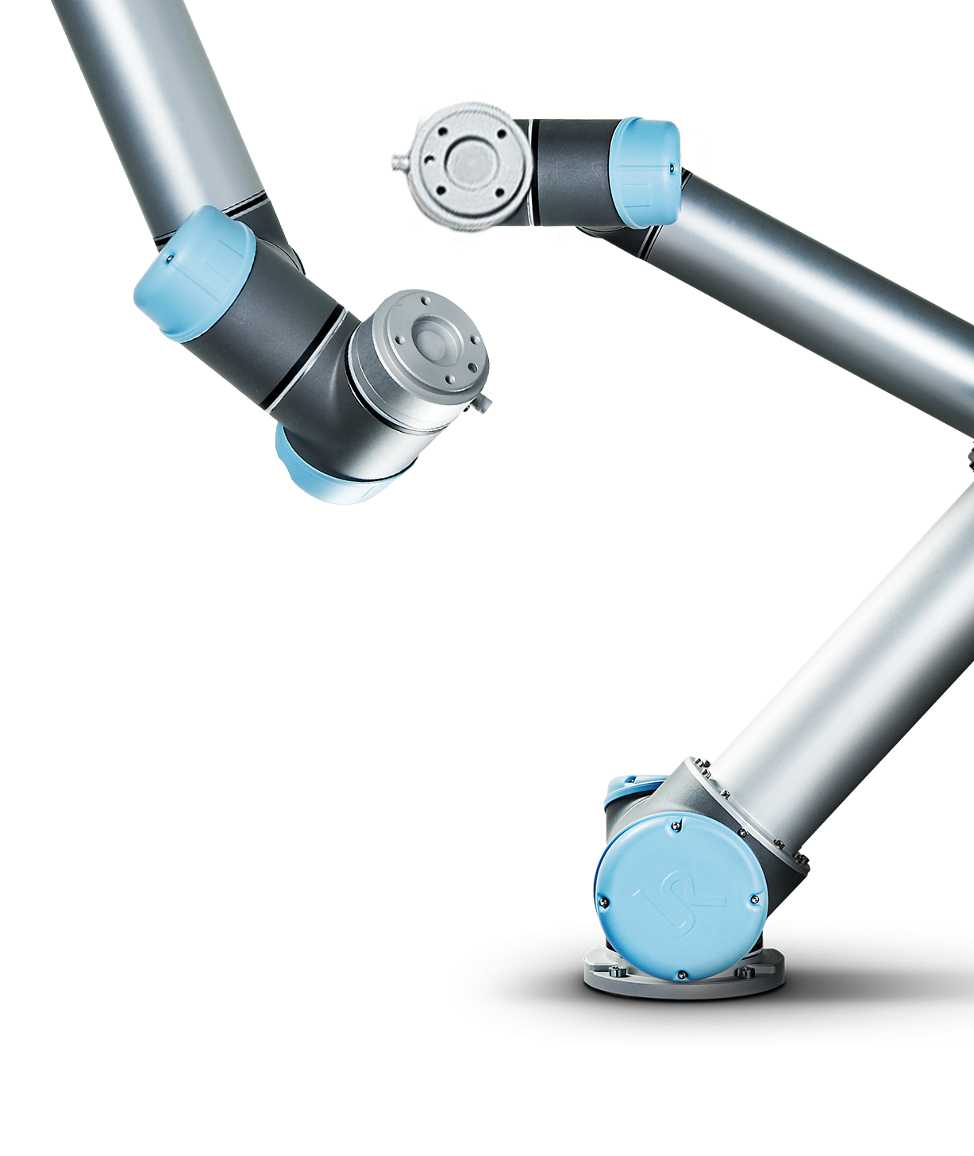
Universal Robots
Advanced Training

Slide 2
Welcome to Advanced Training
A practical hands-on experience
USB stick with simulator
30 min. multi-choice examination at end of training

Slide 3
Presenting the Trainer
Name: <Name>
Role: <Job description>

Slide 4
1
URScript
6
FTP Server
2
Variables
7
Dashboard Server
3
Features
8
Client Interfaces
4
Advanced use of TCP
9
Socket Communication
5
Modbus Server
10
Program Troubleshooting

Slide 5
1
URScript
1
UR Script
6
FTP Server
2
Variables
7
Dashboard Server
3
Features
8
Client Interfaces
4
Advanced use of TCP
9
Socket Communication
5
Modbus Server
10
Program Troubleshooting

Slide 6
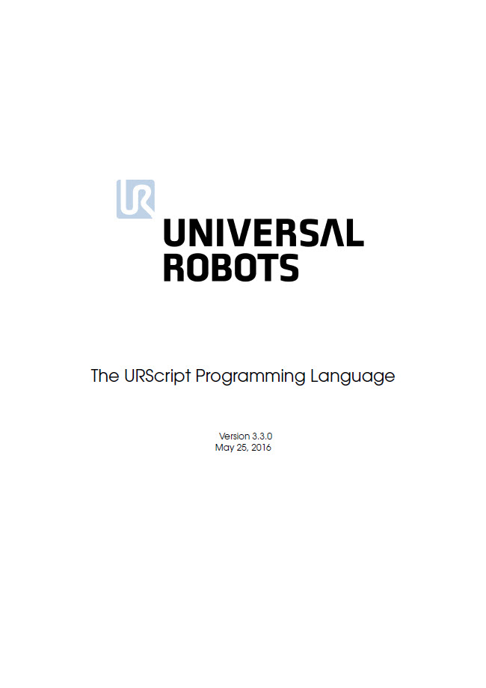
URScript
1
What is URScript?
URScript
High level script language developed by UR
Can be used instead of building program structure in the Polyscope GUI
Similarities to Python script language
Script manual contains definitions of all available script codes
Polyscope programs are converted to URScript before execution
A number of potential approaches to using URScript
Notes:
What is URScript?
Introduction to script

Slide 7
URScript
1
How to use URScript
There are a number of ways to use URScript
Assignment
Script Code – Line
Script Code – File
Calling functions
Client Interfaces
Notes:
How to use URScript
Explain the different options of using script

Slide 8
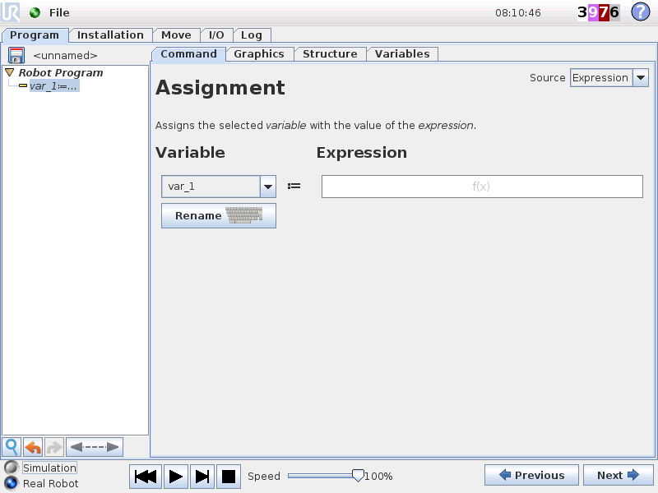
URScript
1
Assignment
Executes script command
Assigns returned value to a variable.
Allows values returned to be viewed in variables window.
Notes:
Assignment

Slide 9
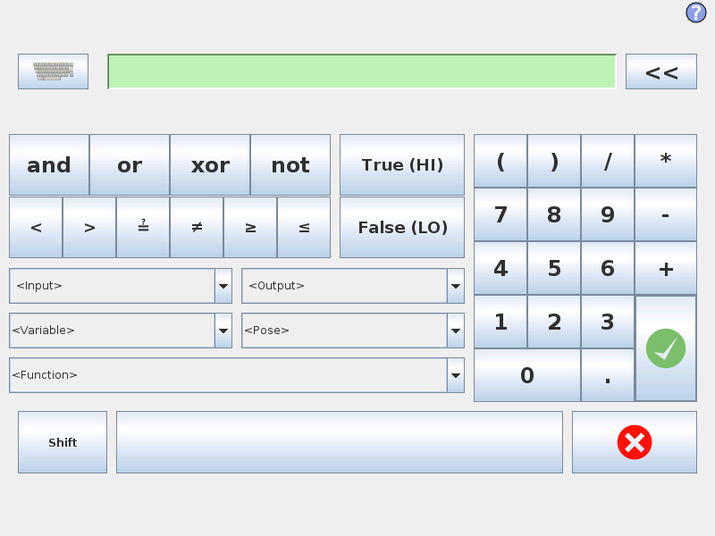
URScript
1
Expression Editor
Most common script codes listed
Saves having to type out whole commands
Sample program using force()
Robot Program MoveL Waypoint_1 IF force() < 30 Waypoint_2
Notes:
Expression editor
Create sample program:
1. Insert vertical linear movement between two waypoints.
2. Reduce speed to 100 mm.
3. Move the bottom waypoint inside of an IF-command
4. Define condition in IF to be force() < 30 :it might be required to adjust the value
5. IMPORTANT: Make sure to check the box ”Check expression continuously”
Demonstrate how it is possible to stop the downward movement by hand.
Show the variable tab and verify the force value changes while running the program

Slide 10
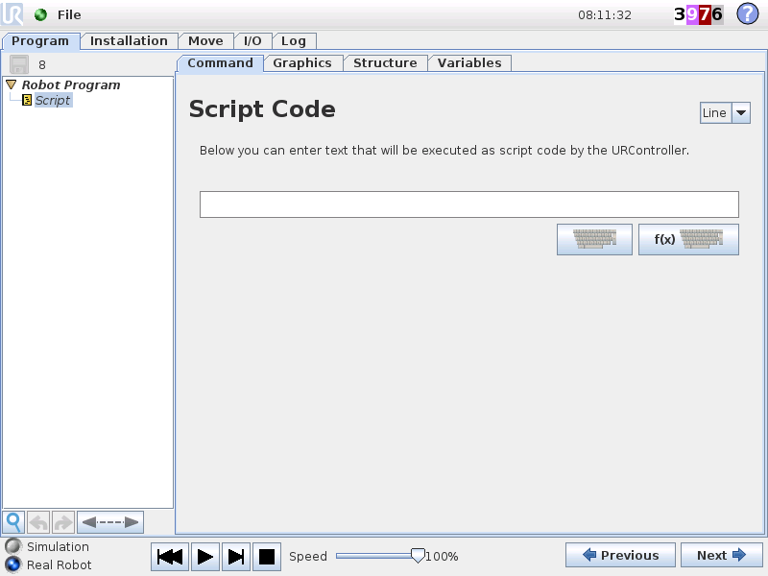
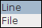
URScript
1
Script Code - Line
Execute a single line of URScript
Variables defined in script do not appear in Variables window
Waypoints in script do not appear in Graphics window
Robot Program movel(p[0,-0.4,0.3,0,3.14,0]) sleep(1) movel(p[0.2,-0.4,0.3,0,3.14,0])
Notes:
Script code – line
Make sample with three script lines

Slide 11
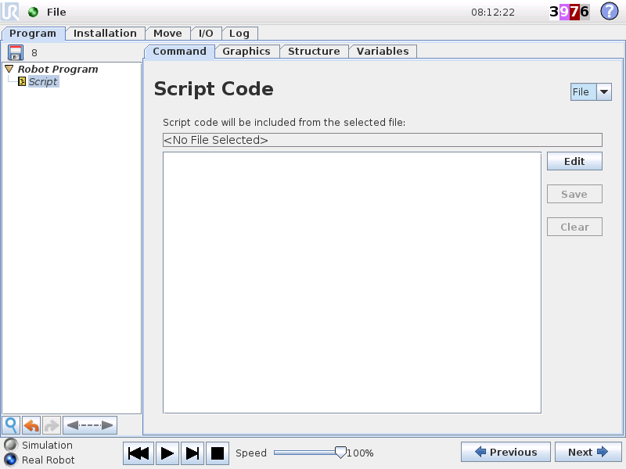
URScript
1
Script Code - File
Load and run an existing script file
Execute multiple lines of script
File transfer over ethernet covered later in training session
Select Edit-button
Notes:
Script code – file
Create and save new script file

Slide 12
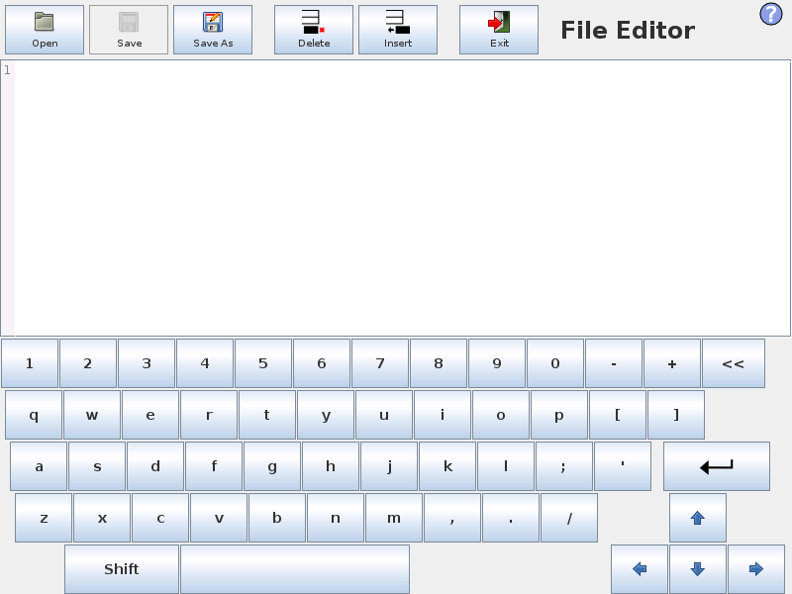
URScript
1
Script Code – Open file
Select Open button to open an existing .script file
Notes:
Script code – file
Create and save new script file

Slide 13
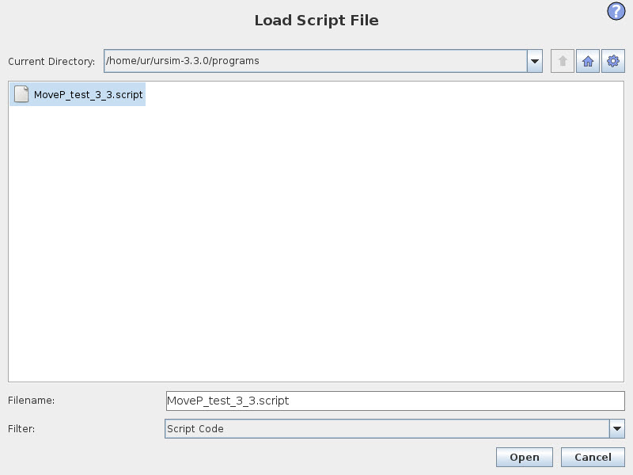
URScript
1
Script Code - Open file
The Filter will automatically show all .script file.
Older version may not, so you have you select All in Filter
Select Open when finished
Notes:
Script code – file
Create and save new script file

Slide 14
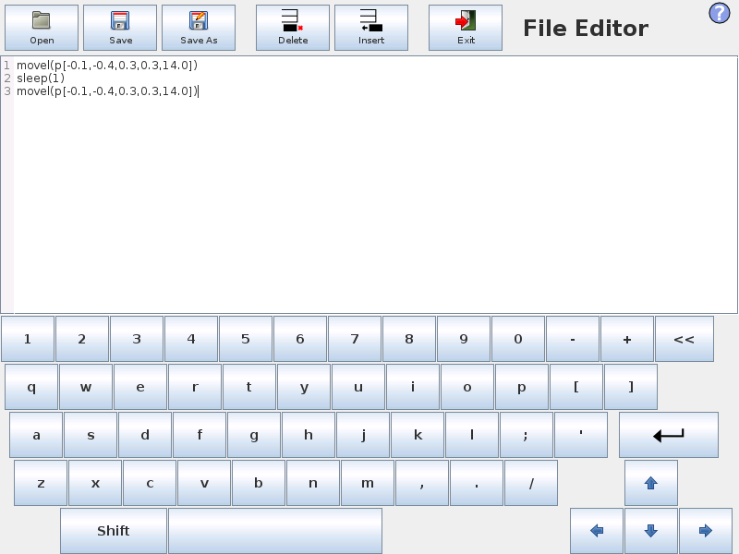
URScript
1
Script Code – Create new file
Insert three new lines
Write script code for each line
Save & Exit
Notes:
Script code – file
Create and save new script file

Slide 15
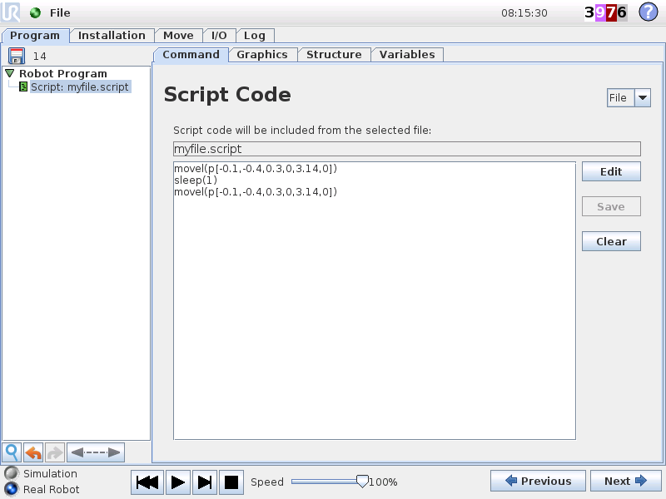
URScript
1
Script Code - File
Run program
Notes:
Script code – file
Create and save new script file

Slide 16
URScript
1
A function in script is declared as
def name()
script
…
end
A function can take argument and return processed argument
def name(argument)
…
…
return
end
A function can be called multiple times within a program
Script Code - Functions
Notes:
Script code – Functions

Slide 17
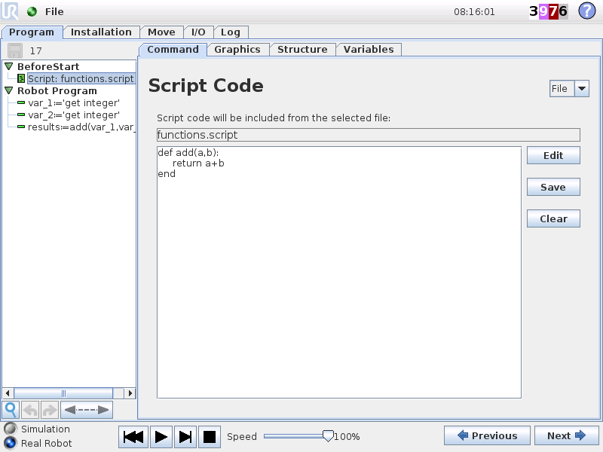
URScript
1
Script Code - Functions
Function that adds two values and returns result
Create script file with function
Give function a name
Define two arguments
Insert return
Declare two variables with operator input
Declare variable and assign the function incl. arguments
Notes:
Script code – Functions
Demonstrate how to call a function.
In this case, a simple calculator

Slide 18
URScript
1
Client Interfaces
Script codes can be sent directly to the controller over Ethernet from an external machine
3 client interfaces running automatically at boot
Explained later in client interfaces section
Notes:
Client interfaces

Slide 19
URScript
1
Lab Exercise
Write a short URScript file that:
Defines a function
Receives an argument
Processes the received value
Returns the processed value
Load this file into a program
Call function from assignment
Execute program
View results
Notes:
URScript Lab Exercise

Slide 20
1
UR Script
6
FTP Server
2
Variables
Dashboard Server
2
Variables
7
3
Features
8
Client Interfaces
4
Advanced use of TCP
9
Socket Communication
5
Modbus Server
10
Program Troubleshooting

Slide 21
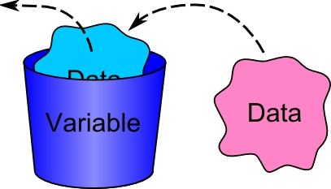
Variables
2
What is a Variable
Core Training
Wrap-up
Variable is a storage location (container)
Content of container can change
Variables are read and write
Value can be overwritten
Value can be read
Variable can be compared with other variable or sensor state
Notes:
What is a variable?
A variable is a storage location (container).
Content (value) of the container can change.
Variables (in PolyScope) are read and write:
» Value can be overwritten by the program
» Value can be read and compared with another variable or sensor state

Slide 22
Variables
2
Variable Types
Core Training
Wrap-up
var type | value
boolean | true/false
integer | whole number (32 bit)
floating point | real number (decimal)
string | text (ASCII characters)
pose | position variable p[x,y,z,rx,ry,rz]
list | array of variables
Notes:
Variable type
PolyScope can use a range of different variable types
» boolean
» integer
» floating point
» string
» pose
» list (contains a list of other variables)
EXAMPLE:
» A variable of boolean type can contain either True or False

Slide 23
Variables
2
Variable Types
Core Training
Wrap-up
scope | location
local | program
global | installation
Local variables
Declared in program
Accessible from same program
Value cleared at power down
Global variables
Declared in Installation
Accessible from programs using same Installation
Value stored in file on disk
Notes:
Variable scope
PolyScope distinguishes between:
» Local variables
» Global variables

Slide 24
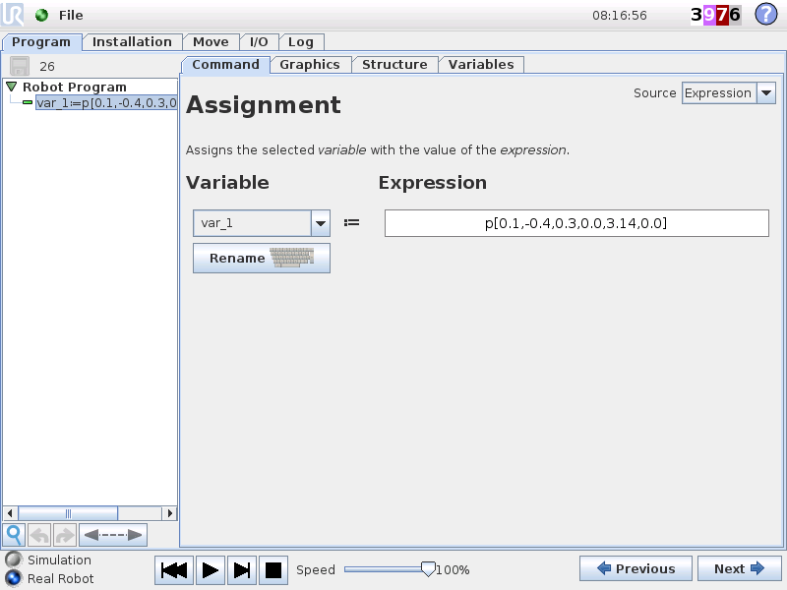
Variables
2
How to insert a variable
Core Training
Wrap-up
Assignment command
Define variable name
Declare variable type
Assign value to variable
Robot Program var_1 = True Wait 0.5 var_1 = False Wait 0.5
Notes:
How to insert variable
Make sample program where a local boolean variable changes state every 500 ms
Save program as var_bool.urp

Slide 25
Variables
2
Pose Variable
Definition
A vector describing the location and orientation in Cartesian space.
Combination of
position vector (x,y,z)
rotation vector (rx,ry,rz)
Units
x,y,z = meters
rx,ry,rz = radians
pose_var = p[ x , y , z , rx , ry , rz ]
variable name
TCP position
rotation vector
Notes:
Pose variable
Explain the definition of pose variable
No theoretical limit to the amount of variables available, but system might have slower respons if +50 pose variables are used

Slide 26
Variables
2
Working with pose Variables
Manual input of pose
Insert Assignment
Define variable name
Enter expression as pose e.g.:
x = 100 mm
y = -400 mm
z = 300 mm
rx = 0
ry = 3.14
rz = 0
Notes:
Working with pose variables
All pose variables will be listed in dropdown box, both Installation and Program variables.

Slide 27
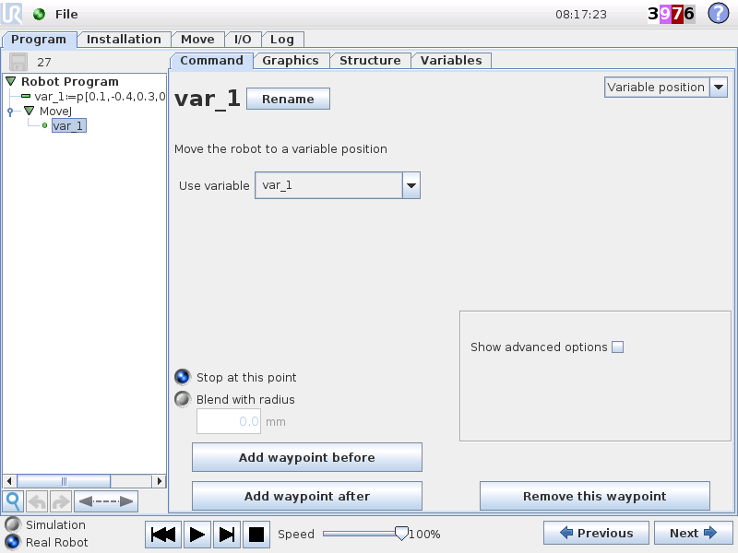
Variables
2
Working with pose Variables
Move to pose
Insert Move
Select variable position
Use variable
NOTE: If first waypoint in program is variable or relative, the AutoMove function will be skipped
Notes:
Working with pose variables
All pose variables will be listed in dropdown box, both Installation and Program variables.

Slide 28
Variables
2
A number of script functions for pose variables are available
Script functions for pose variables
Script code | Function
get_actual_tcp_pose() | Returns the current measured TCP pose
get_actual_tcp_speed() | Returns the current measured TCP speed
get_inverse_kin() | Inverse kinematics
get_target_tcp_pose() | Returns the current target TCP pose
get_target_tcp_speed() | Returns the current target TCP speed
interpolate_pose(p_from, p_to, alpha) | Linear interpolation of tool position and orientation
pose_add(p_1, p_2) | Pose addition
pose_dist(p_from, p_to) | Returns distance between two poses
pose_inv(p_from) | Get the inverse of a pose
pose_sub(p_to, p_from) | Pose subtraction
pose_trans(p_from, p_to) | Pose transformation
Notes:
Scrip functions for pose variables
Three script codes will be explained in the following slides:
get_actual_tcp_pose()
pose_add()
pose_trans()

Slide 29
Variables
2
How to read current position and move up to safe position
Add BeforeStartSequence
Read current position, save in variable
Save z-value in other variable
Define new pose variable
Same pose as current except z-value
Set z-value to 400 mm.
Move to safe_pos variable
Reduce speed
Example: get_actual_tcp_pose()
Pose designations
p[x,y,z,rx,ry,rz] | index no.
x | [0]
y | [1]
z | [2]
rx | [3]
ry | [4]
rz | [5]
BeforeStartSequence cp = get_actual_tcp_pose() z = cp[2] safe_pos = p[cp[0], cp[1], 0.4, cp[3], cp[4], cp[5]] Wait 1 MoveL safe_pos Robot Program Halt
Notes:
get_actual_tcp_pose()
Function reads the Cartesian position as seen in Move-tab (select Base as Feature)
Save as get_actual_tcp_pose.urp

Slide 30
Variables
2
Example: pose_add()
How to move from reference position to variable pick position
Simulate data from vision
e.g. object is offset from refpoint:
x = 250 mm
y = 120 mm
rz = 31 degrees
Define pose variable containing the offsets
Add variable to refpoint using pose_add()
pose_add() uses Base as reference
BASE feature as reference
refpoint
X
Y
RZ
Robot Program MoveJ refpoint Wait DI[0] = True Calc-folder x = 250 y = 120 rz = 31 offset = p[(x/1000),(y/1000),0,0,0,d2r(rz)] pick_pos = pose_add(refpoint, offset) MoveL pick_pos
X
BASE
Y
Notes:
pose_add()
Adds two poses together, uses Base as reference
Save as pose_add.urp

Slide 31
Variables
2
Example: pose_trans()
In a real application it is very unlikely that the vision frame will be aligned with the base frame
If we use pose_add() here, it will be very difficult to reach the correct target
We need to transform our X and Y into the target frame
This is where pose_trans() comes in.
Base Feature as reference
X
refpoint
Y
RZ
X
BASE
Y
Notes:
pose_trans()
Transforms first pose in expression using second pose as reference
Save as pose_trans.urp
TIP: Refpoint can be replaced with a user-defined Feature, then this Feature becomes reference

Slide 32
Variables
2
Example: pose_trans()
Refpoint as reference
How to move from reference position to variable pick position
Simulate data from vision
e.g. object is offset from refpoint:
x = 250 mm
y = 120 mm
rz = 31 degrees
Define pose variable containing the offsets
Add variable to refpoint using pose_trans()
pose_trans() uses first pose as reference
X
refpoint
RZ
Y
Robot Program MoveJ refpoint Wait DI[0] = True Calc-folder x = 250 y = 120 rz = 31 offset = p[(x/1000),(y/1000),0,0,0,d2r(rz)] pick_pos = pose_trans(refpoint, offset) MoveL pick_pos
X
BASE
Y
Notes:
pose_trans()
Transforms first pose in expression using second pose as reference
Save as pose_trans.urp
TIP: Refpoint can be replaced with a user-defined Feature, then this Feature becomes reference

Slide 33
Variables
2
Lab Exercise part 1
Starting from the robot’s current position, create a square trajectory with 10cm sides:
Use:
get_actual_tcp_pose()
pose_trans()
MoveL
create a square with
Use variable x to define side length
x
a
b
x
c
d
Notes:
Variables Lab Exercise

Slide 34
Variables
2
Lab Exercise part 2
Take program from exercise part 1, using same variables
Move around the square 3 times
Add 5cm to the side length each time
10cm
15cm
20cm
Notes:
Variables Lab Exercise

Slide 35
1
UR Script
6
FTP Server
2
Variables
7
Dashboard Server
3
Features
Client Interfaces
3
Features
8
4
Advanced use of TCP
9
Socket Communication
5
Modbus Server
10
Program Troubleshooting

Slide 36
Features
3
Feature is a Cartesian coordinate system
A coordinate system defines a plane or space by axes from a fixed point called the origin
Feature is saved as a pose variable
What is a Feature
Z
RZ
RX
X
origin
Y
RY
Notes:
What is a Feature?

Slide 37
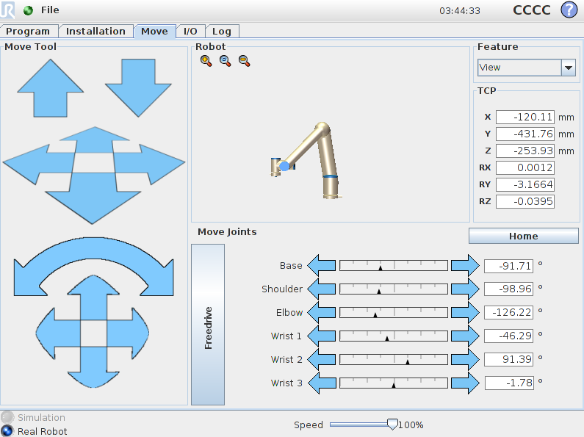
Features
3
Robot operates relative to features
Base feature
Tool feature
Tool position
X, Y, Z = position of TCP
Unit: mm / inch
Rx, Ry, Rz = orientation
Unit: radians
NOTE: Orientation is given as a rotation vector, where the length of the vector is the angle to be rotated in degrees
What is a Feature
Notes:
What is a feature?
The rotation is not in Euler angles.
They are defined as a rotation vector.
The three values are the X-Y-Z values of the vector and the Euclidean norm is the rotation around this vector in radians.

Slide 38
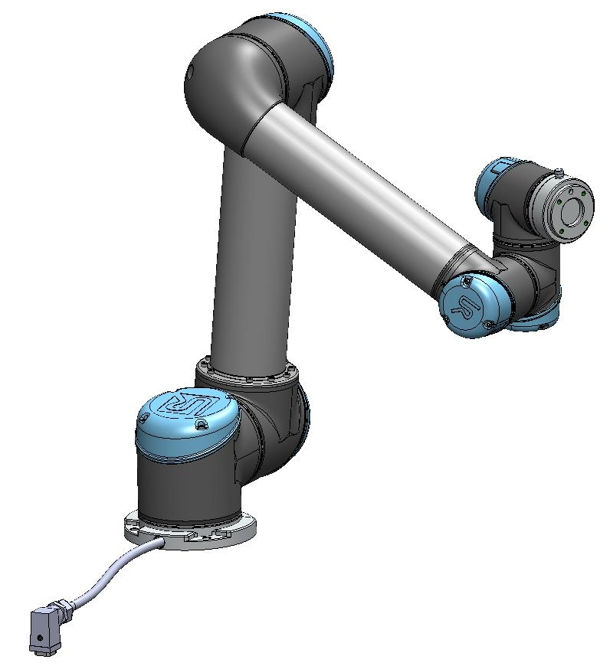
Features
3
Base feature
Located at the base of the robot
Origin in centre of base
Z
RZ
RX
X
Y
RY
Notes:
Base feature
Base coordinate system = also known as World Coordinates in other robot programming languages

Slide 39
Features
3
Tool feature
Origin in centre of tool flange
RZ
Z
RY
X
RX
Y
Notes:
Tool feature
Tool feature is dynamic, as it always has its origin in center of TCP

Slide 40
Features
3
Tool feature
Origin in centre of TCP
RZ
Z
RY
X
RX
Y
Notes:
Tool feature
When TCP is defined, origin of the Tool feature will be in center of TCP

Slide 41
Features
3
User defined feature
Defined by the operator
Z
Y
RZ
RY
X
RZ

Slide 42
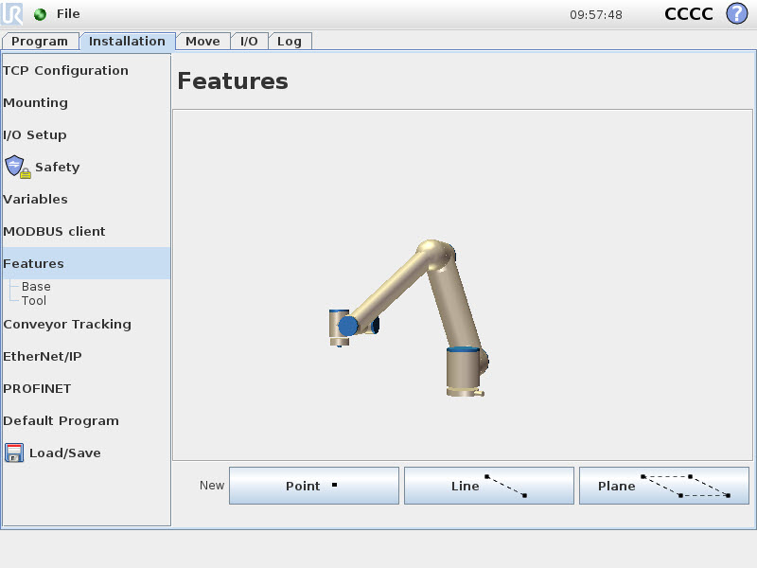
Features
3
Features
In PolyScope a Plane is defined as a Feature
Multiple Features can be set
Set Feature as
Point
Line
Plane
Add Feature
Plane
Setup Feature
Notes:
Setup feature

Slide 43
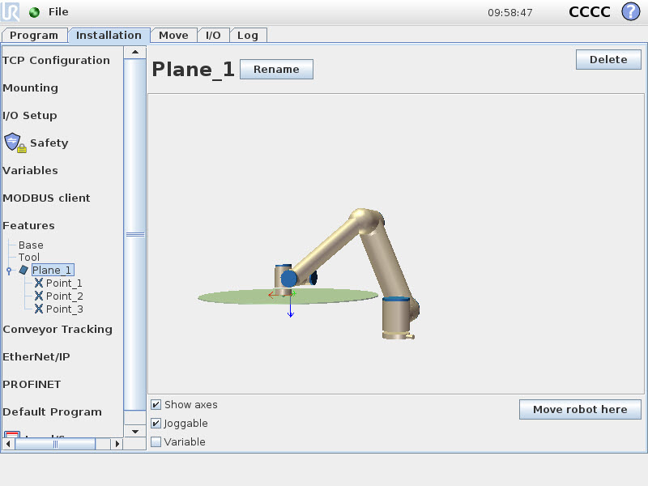
Features
3
Properties
Show axes
Display colors
Joggable
Enable feature in Move-tab
Variable
Create a copy of the feature
Move robot here
Position TCP perpendicular to feature
Setup Feature
Notes:
Setup feature
Feature is fixed, but if Variable is selected, then a copy of the feature can be modified
Demonstrate how to define a feature as Plane
» Click Plane-button to add new plane
» Use A4 sheet or similar to create feature

Slide 44
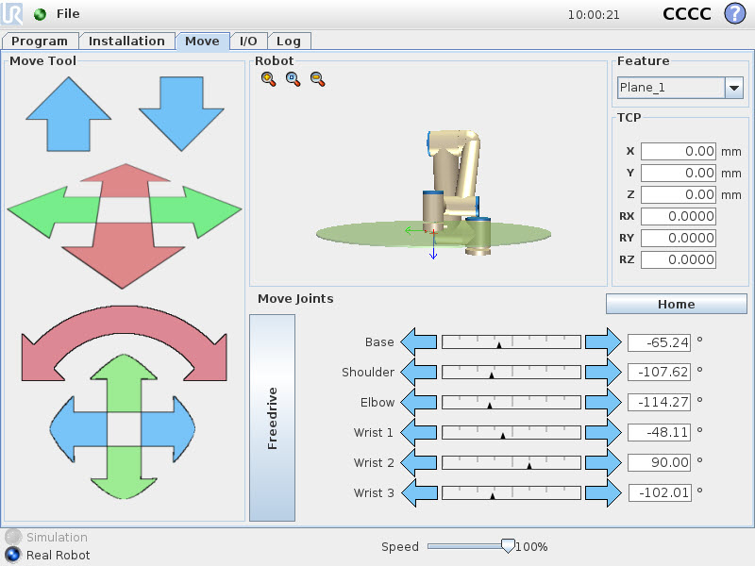
Features
3
Select Feature
Jog using arrow keys
Expression editor
Jog relative to Feature
Notes:
Jog relative to Feature
Go to MOVE-tab and select the Plane as feature
Demonstrate how to jog relative to the user-defined Feature

Slide 45
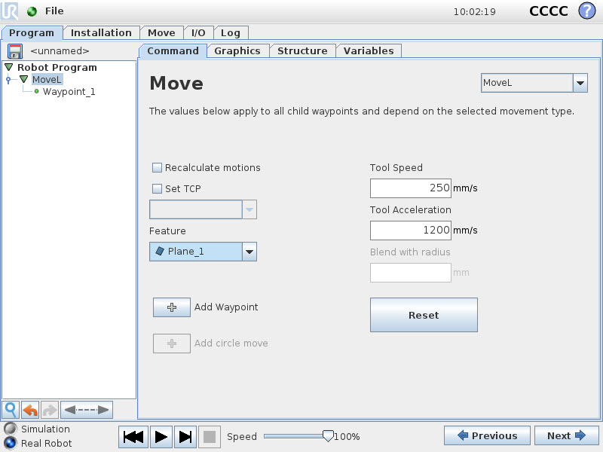
Features
3
Move-command
Feature applicable to
MoveL
MoveP
MoveC
Shared parameters
Select user-defined feature
Jog relative to Feature
Notes:
Working with Features
MoveJ waypoints are always with respect to angular positions, so Feature can not be selected

Slide 46
Features
3
Create program
Insert MoveJ
Teach home pose
Insert MoveL
Select Plane_1 as Feature
Teach 4 waypoints
Run program
Re-teach Feature
Check Feature as Variable
Verify waypoints are shifted
Working with Features
home
wp1
wp4
wp2
wp3
Robot Program MoveJ home MoveL Waypoint_1 Waypoint_2 Waypoint_3 Waypoint_4 Waypoint_1
Plane_1
Plane_1 re-taught
Notes:
Working with Features
Demonstrate how to teach waypoints relative to user-defined feature
Then modify the Feature and verify that the entire program is shifted accordingly
Save as feature.urp

Slide 47
Features
3
Use sample program
Use script code to offset Feature
pose_add()
pose_trans()
How to
Define offset in Y
Use offset in pose var
Use pose var to offset feature
Working with Features
home
wp1
wp4
wp2
Robot Program MoveJ home y = 0.05 offset = p[0,y,0,0,0,0] Plane_1_var = pose_trans(Plane_1_var,offset) MoveL Waypoint_1 Waypoint_2 Waypoint_3 Waypoint_4 Waypoint_1
wp3
Plane_1
Plane_1 offset
Notes:
Offset Feature
Make sample program, where the offset is accumulated for every cycle
Save as offset_feature.urp

Slide 48
Features
3
Use sample program
Create two Features
Plane_1
Plane_2
Use two inputs to switch Feature
If DI[0] is high, use Plane_1
If DI[1] is high, use Plane_2
Working with Features
home
wp1
wp4
wp2
Robot Program MoveJ home IF DI[0] = True Plane_1_var = Plane_1 ELSEIF DI[1] = True Plane_1_var = Plane_2 MoveL Waypoint_1 Waypoint_2 Waypoint_3 Waypoint_4 Waypoint_1
wp3
Plane_1
Plane_2
Notes:
Switch between multiple Features
Make sample program, where the offset is accumulated for every cycle
Save as switch_between_features.urp

Slide 49
Features
3
Create two feature planes:
Plane_1
Plane_2
Set them as variable
Save Installation
Lab Exercise part 1
Plane_1
Plane_2
Notes:
Features Lab Exercise

Slide 50
Features
3
Create a program:
Add a MoveL
Set feature in MoveL as Plane_1
Add 4 waypoints to MoveL
Set first waypoint at origin of Plane_1
Lab Exercise part 2
wp2
wp1
wp3
wp4
Notes:
Features Lab Exercise

Slide 51
Features
3
Once the MoveL is complete
Offset plane_1 +10cm in y direction
Repeat MoveL
Offset another 10cm in same direction
Repeat MoveL
Lab Exercise part 3
wp2
wp1
wp2
wp1
wp3
wp2
wp1
wp4
wp3
Offset 1
wp4
wp3
Offset 2
wp4
Notes:
Features Lab Exercise

Slide 52
Features
3
After the third MoveL has been completed
Set plane_1_var to the second feature (plane_2)
Execute the movements in the plane_2 feature frame.
Lab Exercise part 4
Plane_1_Var = Plane_1
wp2
wp1
wp2
wp1
wp3
wp2
wp1
wp4
wp3
wp4
wp3
Offset 2
wp4
Switch to Feature 2
Plane_1_Var = Plane_2
wp2
wp1
wp2
wp1
wp2
wp1
wp3
wp3
wp4
wp3
wp4
wp4
Notes:
Features Lab Exercise

Slide 53
1
UR Script
6
FTP Server
2
Variables
7
Dashboard Server
3
Features
8
Client Interfaces
4
Advanced use of TCP
9
Socket Communication
4
Advanced use of TCP
5
Modbus Server
10
Program Troubleshooting

Slide 54
Advanced use of TCP Features
4
Definition:
Centre of gravity is the location where tool payload is balanced
Script code
set_payload(m, CoG)
m = mass in kilogram
CoG = Center of Gravity (CoGx, CoGy, CoGz) in meters
NOTE:
If CoG is not defined, software will use TCP as CoG.
Centre of Gravity (CoG)
TCP
CoG
Notes:
Center of Gravity (CoG)
= centerpoint of tool weight
Tip: demonstrate CoG with a pen on your fingertip.
If pen stays horizontal, you have demonstrated CoG of pen

Slide 55
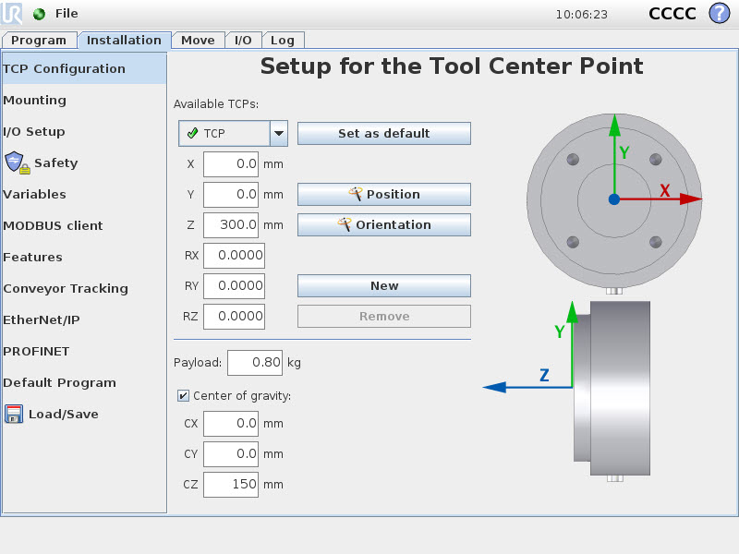
Advanced use of TCP Features
4
GUI TCP Payload settings
Easiest way to define CoG
(see next slide)
Still need to use script code if CoG changes a lot during execution.
Centre of Gravity (CoG)
Notes:
Center of Gravity (CoG)
= centerpoint of tool weight
Tip: demonstrate CoG with a pen on your fingertip.
If pen stays horizontal, you have demonstrated CoG of pen

Slide 56
Advanced use of TCP Features
4
The TCP position can be determined by moving the tool tip to the same position from 3 different angles
Once you have taught these positions the TCP x,y,z values will be calculated
Adding a fourth pose improves accuracy
Teaching TCP Position
Notes:
Center of Gravity (CoG)
= centerpoint of tool weight
Tip: demonstrate CoG with a pen on your fingertip.
If pen stays horizontal, you have demonstrated CoG of pen

Slide 57
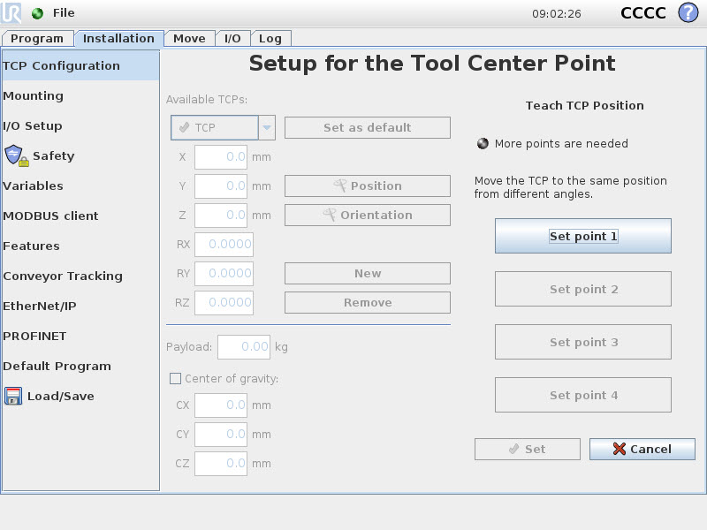
Advanced use of TCP Features
4
Click Position button to Teach TCP Position
Set 3 or 4 points
Indicator LED will show status of TCP calculation and quality of each point
Teaching TCP Position
Notes:
Tool feature
When TCP is defined, origin of the Tool feature will be in center of TCP

Slide 58
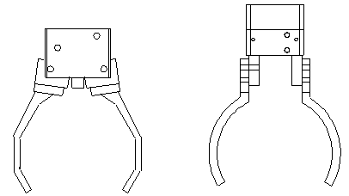
Advanced use of TCP Features
4
Setup TCP
In Installation-tab only one TCP can be setup.
Script code can be used for setting up multiple TCP’s
Script code
set_tcp(pose)
pose = p[x,y,z,rx,ry,rz]
Installation
Set Base feature as variable
NOTE:
Only MoveL and MoveP will be affected by set_tcp()
Multiple TCP
x2
x1
ry2
z2
z1
tcp2 = p[x2,0,z2,0,ry2,0]
tcp1 = p[x1,0,z1,0,0,0]
Notes:
Multiple TCP
How to use more than one TCP in same program.
It is assumed that tool is rotated only around Y-direction of Tool feature

Slide 59
Advanced use of TCP Features
4
Setup tcp1
x1 = 150 mm.
z1 = 150 mm.
tcp1 = p[0.15, 0, 0.15, 0, 0, 0]
Setup tcp2
x2 = -200 mm.
z2 = 140 mm.
ry2 = -25 °
tcp2 = p[-0.2, 0, 0.14, 0, d2r(-25), 0]
Multiple TCP
x2 = -200
x1 = 150
zy2 = -25°
z2 = 140
z1 = 150
tcp2 = p[x2,0,z2,0,ry2,0]
tcp1 = p[x1,0,z1,0,0,0]
Notes:
Multiple TCP
Use script code d2r() for converting -25 degrees to radians

Slide 60
Advanced use of TCP Features
4
Set TCP_1 as default
TCP_1
x1 = 150 mm.
z1 = 150 mm.
Setting TCP
Notes:
Multiple TCP
Use script code d2r() for converting -25 degrees to radians

Slide 61
Advanced use of TCP Features
4
Click New to add second TCP
TCP_2
x2 = -200 mm.
z2 = 140 mm.
ry2 = -25 °
Rotation must be specified in Radians
25*pi/180 = 0.4363
Setting TCP
Notes:
Multiple TCP
Use script code d2r() for converting -25 degrees to radians

Slide 62
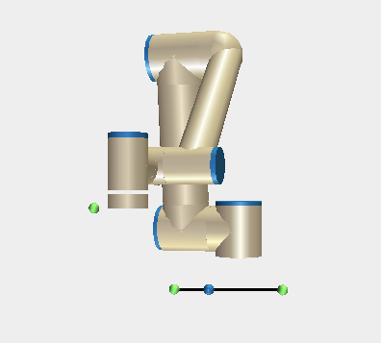
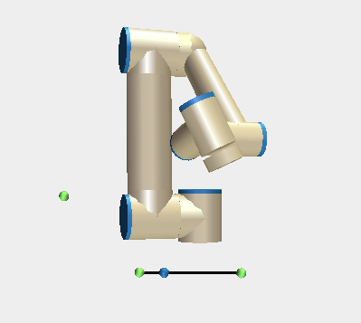
Advanced use of TCP Features
4
Sample program
Set Base feature as variable in Installation-tab
Declare integer variable tcp for switching between multiple tcp’s
Set feature as Base in MoveL-command
Implement in program
BeforeStartSequence tcp = 1 tcp1 = p[0.15,0,0.15,0,0,0] tcp2 = p[-0.2,0,0.14,0,d2r(-25),0] MoveJ home Robot Program IF tcp = 1 set_tcp(tcp1) tcp = 2 ELSEIF tcp = 2 set_tcp(tcp2) tcp = 1 MoveL Waypoint_1 Waypoint_2 Waypoint_1
Notes:
Implement in program
It is important to set Base feature as variable and use Base as feature in MoveL-command

Slide 63
Advanced use of TCP Features
4
Simulate an installation with two tools, one gripper and a screwdriver
Gripper (tcp1)
Z Offset 20cm
Screwdriver (tcp2)
X offset 20cm
Z offset 5cm
RY offset 90°
NOTE:
Only MoveL, MoveP and MoveC will be affected by set_tcp()
Lab Exercise part 1
x2
z2
z1
ry2
tcp2 = p[x2,0,z2,0,d2r(ry2),0]
tcp1 = p[0,0,z1,0,0,0]
Notes:
Advanced use of TCP Lab Exercise

Slide 64
Advanced use of TCP Features
4
Simulate picking then placing a square work piece with gripper, then screwing it in 4 locations.
Set TCP Gripper (tcp1)
Move to a pick point of your choice
Move to a place point of your choice
Set TCP Screwdriver (tcp2)
Use pose_trans() to define 4 fixing points at
x=±7.5cm and y=±7.5cm from place point
Write a subprogram
MoveL to relative waypoint Z+5cm in tool frame
MoveL to relative waypoint Z+5cm in tool frame
Call after every waypoint in main program
Lab Exercise part 2
Notes:
Advanced use of TCP Lab Exercise

Slide 65
1
UR Script
6
FTP Server
2
Variables
7
Dashboard Server
3
Features
8
Client Interfaces
4
Advanced use of TCP
9
Socket Communication
Modbus Server
5
Modbus Server
Program Troubleshooting
5
10

Slide 66
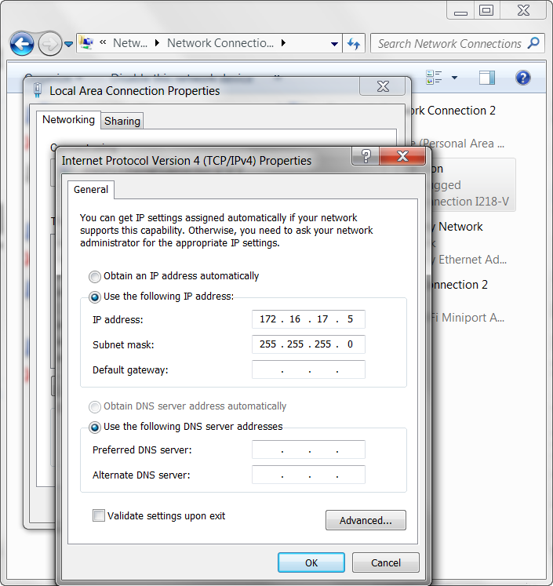
Modbus Server
5
Before any TCP/IP based communication, PC and robot network must be configured.
Under network device properties setup:
IP address
Subnet mask
IP-address on robot and PC should be the same part from the last number. In this case:
192.16.17.x
Both Subnet masks should be
255.255.255.0
PC Network Configuration
Notes:
PC Network Configuration

Slide 67
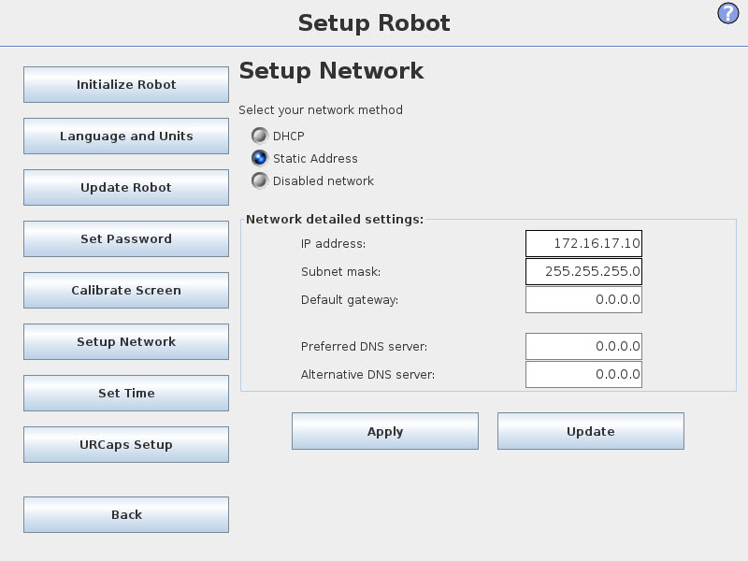
Modbus Server
5
Go to Setup Robot, select Setup Network and setup:
IP-address
Subnet mask
IP address should be in the same format as PC:
192.16.17.x
Subnet mask should be
255.255.255.0
Robot Network Configuration
Notes:
Robot Network Configuration

Slide 68
Modbus Server
5
Core Training
Wrap-up
Modbus TCP
Ethernet based communication protocol
Communication protocol
A protocol is a common language with which two devices can communicate
Possible to transfer data between devices
Client / Server relationship
What is TCP modbus
Device 1
Device 2
Ethernet
Notes:
What is Modbus TCP?
Ethernet based communication protocol
- A communication protocol is a common language with which two devices can communicate.
- Used for data transfer between devices.

Slide 69
Modbus Server
5
Core Training
Wrap-up
Server
One device acts as Server
Listening on requests from Client
Client
Other device(s) acts as Client
Sends requests to Server
Each device must have a unique IP-address
Client / Server
Device 1
Device 2
Modbus client
Modbus server
Notes:
Client / Server
Client/Server is sometimes referred to as Master/Slave
Client = Master
Server = Slave

Slide 70
Modbus Server
5
Core Training
Wrap-up
Available data types for Modbus TCP
Address range
Each digital signal and register have a unique address
Address is always specified in documentation provided by vendor
Data Types
data type | value | address range
Digital inputs | On/Off | Consult documentation provided by vendor of Server device
Digital outputs | On/Off
Register inputs | 16 bit
Register outputs | 16 bit
Notes:
Data types
Available data types

Slide 71
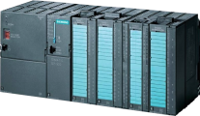
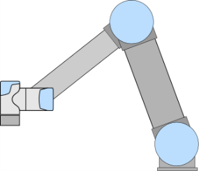
Modbus Server
5
Core Training
Covered how to use robot as Client and connect to a Server
Advanced Training
Will cover how to use the UR Controller as a Server and accept Client connections
UR Modbus Server
Modbus client
Ethernet
Modbus servers
Notes:
UR Modbus Server

Slide 72
Modbus Server
5
Modbus Server is always running on UR Controller
IP Address: Set in robot setup menu
Port no: 502 (no setting needed)
Features:
Modbus Server transmits information about robot state including:
Joint Angle/Velocity/Current/Temperature
TCP Position/Velocity/Offset
Program state – Emergency stopped/ teach mode etc.
I/O can be remotely read/written
I/O state transmitted
Outputs can be controlled from remote device
General purpose registers
128 registers available
Full list of register addresses available on support site
Modbus Server Features
Notes:
Modbus Server features
Explain the options for accessing data on the robot

Slide 73
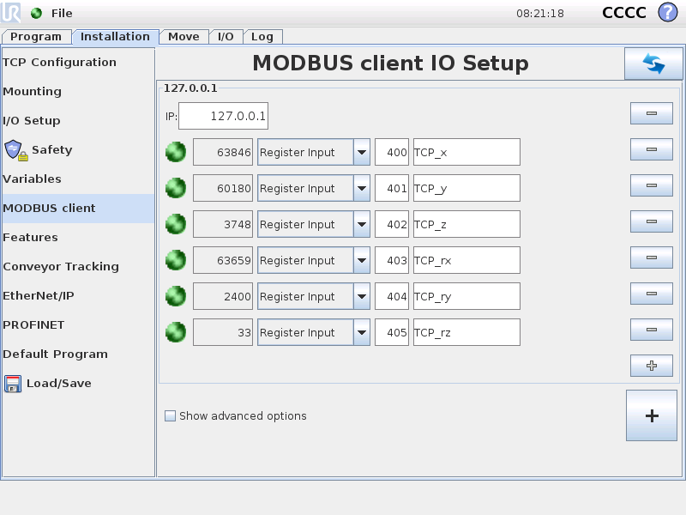
Modbus Server
5
Access robots own Server
IP-address: 127.0.0.1
Read TCP position
Register addresses:
400 TCP-x in tenth of mm
401 TCP-y in tenth of mm
402 TCP-z in tenth of mm
403 TCP-rx in mrad
404 TCP-ry in mrad
405 TCP-rz in mrad
= in Base frame
263 isTeachButtonPressed
Access robot Own server
Notes:
Access robots own Server
Setup and read current TCP position while jogging robot manually

Slide 74
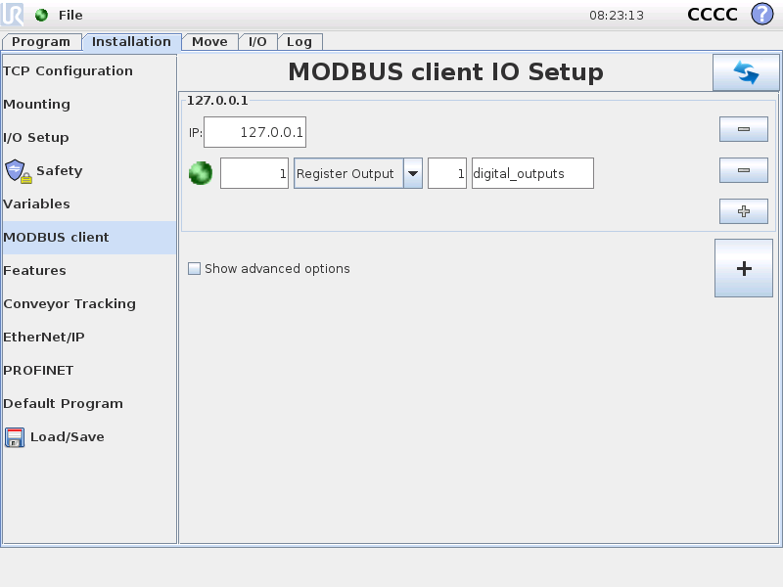
Modbus Server
5
Setup register with digital outputs
Register address = 1
Feature
Allows manipulation of multiple I/O channels in single operation saving processing time.
Format:
16 bit integer registers
[BBBBBBBBTTxxxxxx] B=box , T=tool, x=undef
Access I/O registers
Notes:
Access I/O registers

Slide 75
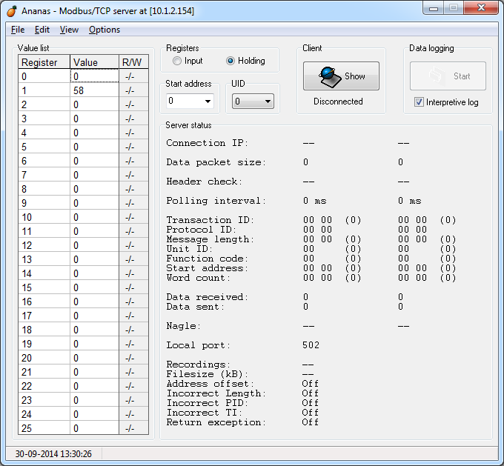
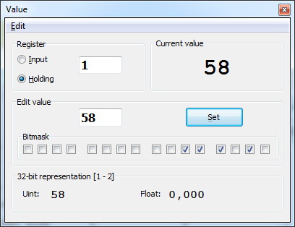
Modbus Server
5
Potential applications for Modbus Server include:
Controlling the robot IO from a remote device
How to test
Install Ananas
Freeware program for testing Modbus functionality
Setup Ananas as Modbus client
Switch digital IO in the controller by checking/unchecking bits or edit integer value
Modbus Applications
Notes:
Modbus Applications
Use Ananas for remote connection from laptop to controller

Slide 76
Modbus Server
5
Write a program to:
Read digital output register
Convert to binary list
Toggle output channel 3
Convert back to integer
Write back to register
Run program and watch output change
Lab Exercise 1
Notes:
Modbus Server Lab Exercise 1

Slide 77
Modbus Server
5
Write a program to receive simulated vision coordinates from Modbus server, then move to received position:
Retrieve pick position variables from Modbus Server general purpose registers
Move to position, based on pose_trans() example from Variables section.
Register addresses:
128: new data available (0=no, 255=yes)
129: x
130: y
131: rz
Lab Exercise 2
Refpoint as reference
X
refpoint
RZ
Y
X
BASE
Y
Notes:
Modbus Server Lab Exercise 2

Slide 78
UR Script
6
FTP Server
1
6
FTP Server
2
Variables
7
Dashboard Server
3
Features
8
Client Interfaces
4
Advanced use of TCP
9
Socket Communication
5
Modbus Server
10
Program Troubleshooting

Slide 79
FTP Server
6
FTP Server
Client/server protocol for file transfers
Ethernet based communication
Purpose
For convenient transfer of program files
Easy backup
Server on UR controller
Server is always running on UR controller
No settings on UR controller needed
What is FTP Server?
PC
Ethernet
UR Controller
File transfer
FTP client
FTP server
Notes:
What is FTP Server?

Slide 80
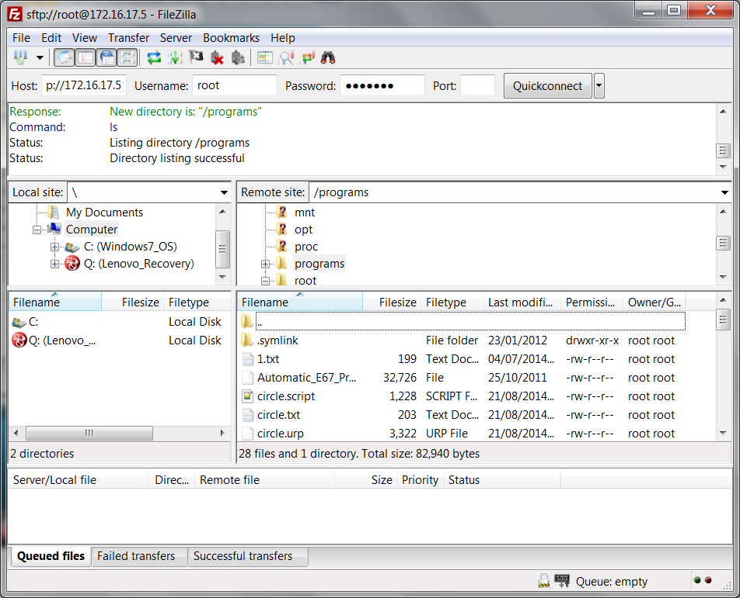
FTP Server
6
FileZilla
Freeware FTP client
filezilla-project.org
Connection via ssh or sftp
How to connect
Setup FileZilla
Host: IP-address on robot
User: root
Password: easybot
Port 22
How to transfer
Drag’n’drop files between PC and /programs folder on controller
WARNING: File system on controller is not write-protected, so incorrect use can cause malfunction
FTP client
Notes:
FTP Server

Slide 81
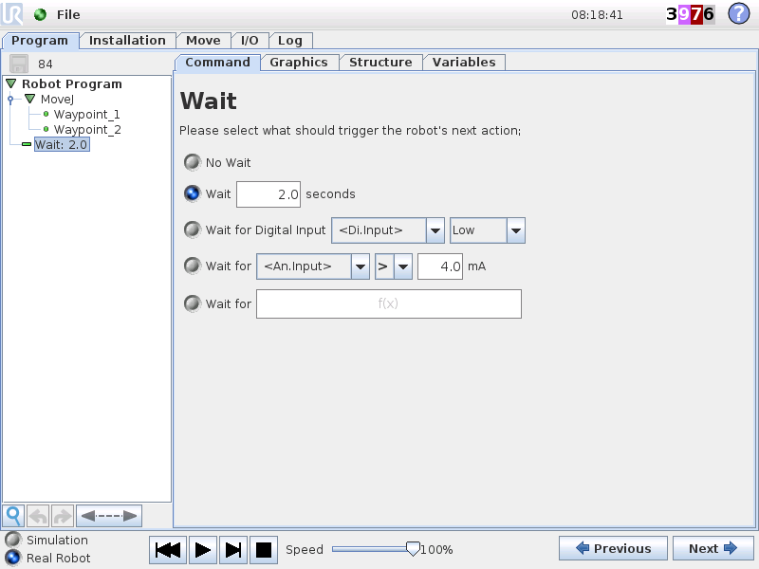
FTP Server
6
Make backup of all files in /programs folder
Write a simple program in URSim on your own laptop
Copy it to the /programs folder
Run program on robot
Lab Exercise
Notes:
FTP Server Lab Exercise

Slide 82
1
UR Script
6
FTP Server
2
Variables
7
Dashboard Server
7
Dashboard Server
3
Features
8
Client Interfaces
4
Advanced use of TCP
9
Socket Communication
5
Modbus Server
10
Program Troubleshooting

Slide 83
Dashboard server
7
The Dashboard Server
Allows remote control of the robot over port 29999.
Control operation of the robot, loading/starting programs
Get feedback about robot state (is program running/loaded)
Show/close popups
Set user access level (disable different parts of the GUI)
Full list of commands is found on support site
What is the Dashboard Server?
Notes:
Dashboard Server
Description of Dashboard functionality

Slide 84
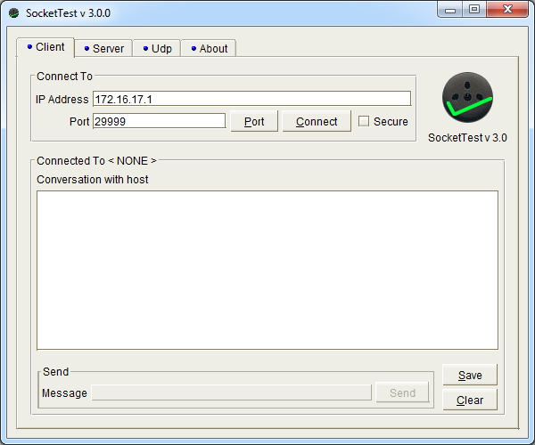
Dashboard server
6
SocketTest
Freeware program for testing TCP/IP socket communication
sockettest.sourceforget.net
How to connect
Setup IP-address on PC and robot
Open SocketTest
Select Client-tab
Insert IP-address of robot
Insert port no of Dashboard Server (29999)
Click Connect
SocketTest
Notes:
SocketTest

Slide 85
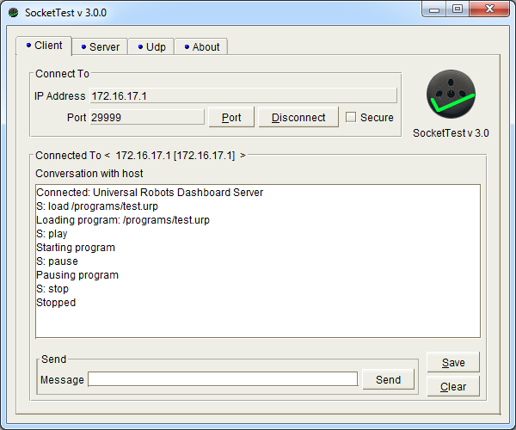
Dashboard server
6
Control robot operation remotely
load <program.urp>
play (starts loaded program)
stop (stops running program)
pause (pauses the running program)
quit (closes connection)
shutdown (shuts down and turns off the robot and controller)
Dashboard remote operations
Notes:
Dashboard remote operations
How to operate robot from remote

Slide 86
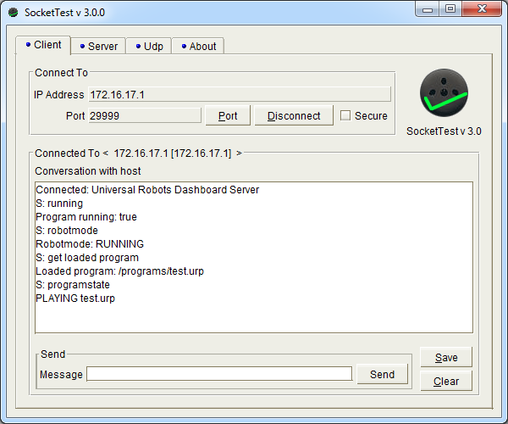
Dashboard server
7
Request robot state
running (execution state enquiry)
robotmode (robot mode enquiry)
Get loaded program (which program is loaded)
isProgramSaved (Returns the save state of the active program)
programState (Returns the state of the active program, or STOPPED if no program is loaded)
Dashboard feedback
Notes:
Dashboard feedback

Slide 87
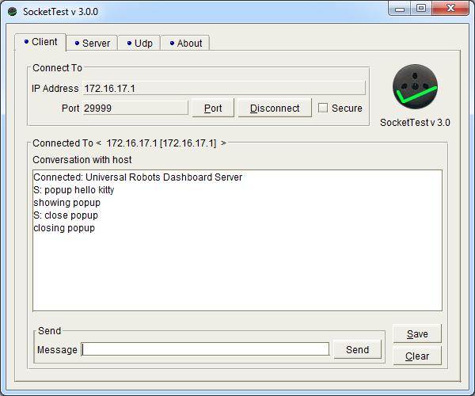
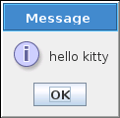
Dashboard server
7
Open and close popups on the GUI
popup <popup-text> (open a popup)
close popup (closes the popup)
Dashboard popups
Notes:
Dashboard popups

Slide 88
Dashboard server
7
Control the available options on the welcome screen
setUserRole <role>
Dashboard User Roles
User roles (<role>) | Description
programmer | ”SETUP Robot” button is disabled, ”Expert Mode” is available (if correct password is supplied)
operator | Only ”RUN Program” and SHUTDOWN Robot” buttons are enabled, ”Expert Mode” cannot be activated
none | All buttons enabled, ”Expert Mode” is available (if correct password is supplied)
locked | All buttons disabled and ”Expert Mode” cannot be activated
Notes:
Dashboard User Roles

Slide 89
Dashboard server
7
Return robot to the welcome screen
Connect to the dashboard server
Load the program you transferred to the robot via FTP
Play the program
Lab Exercise
Notes:
Dashboard Lab Exercise

Slide 90
1
UR Script
6
FTP Server
2
Variables
7
Dashboard Server
Features
Client Interfaces
3
8
Client Interfaces
8
4
Advanced use of TCP
9
Socket Communication
5
Modbus Server
10
Program Troubleshooting

Slide 91
Client Interfaces
8
What are Client interfaces?
Servers that are always running on UR controller
Functionality
Servers continuously sends stream of data about robot state
Clients can send URScript commands to Servers
(Servers are always waiting for incoming commands)
What are Client Interfaces?
PC
UR Controller
Ethernet
Data transfer
Client
Server
Notes:
What are Client interfaces?

Slide 92
Client Interfaces
8
Available interfaces
Real Time Client Interface is faster than Primary/Secondary
Available interfaces
 | Primary | Secondary | Real Time | Real-Time Data Exchange (RTDE)
Transmit | Robot State and additional messages | Robot State messages | Robot State messages | Robot State messages
Receive | URScript commands | URScript commands | URScript commands | URScript commands
Port no. | 30001 | 30002 | 30003 | 30004
Notes:
Available interfaces
Primary and Secondary = 10Hz
Real time and RTDE = 125Hz

Slide 93
Client Interfaces
8
Datastream
Transmitted data stream contains a large amount of data
Mainly used for communication between GUI and controller
Need to write a program to extract required data from received bytes
More information on support site
A lot of work to receive data, not always the best option
Transmitted Datastream
Notes:
Transmitted Datastream

Slide 94
Client Interfaces
8
Send to client interface
Client Interfaces most useful for sending URScript commands from remote machine
Individual commands executed in order as received
Send a function and execute later
Can write a program in script and execute it without using the GUI.
Sending Commands
Notes:
Sending commands

Slide 95
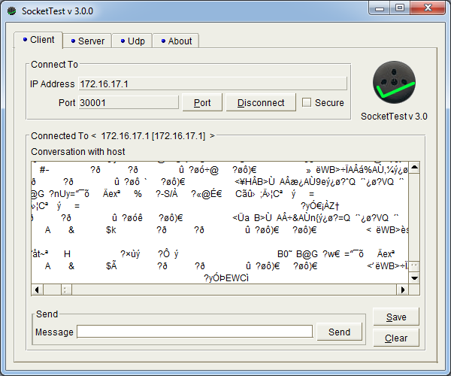
Client Interfaces
8
Open SocketTest
Select Client
Set port no. 30001
Connect
Send sample commands, e.g:
popup()
set_digital_out()
movel()
speedj()
Refer to URScript manual for detailed explanation of script codes syntax
Sending Commands
Notes:
Sending Commands

Slide 96
Client Interfaces
8
From SocketTest send commands to the robot (or URSIM) client interfaces to do the following, (consult the URScript manual for the correct syntax):
Move the Robot TCP in the Base frame with the following parameters:
Z velocity = 0.3 m/s
X, Y, RX, RY, RZ velocity all = 0 m/s.
Timeout = 1 second
Acceleration = 0.5m/s²
Move the Robot TCP in the Tool frame with the following parameters:
Z = Z + 0.1 m (add 0.1 m to the current TCP Z value)
Move in Linearly in tool space
Velocity = 0.2 m/s
Acceleration = 0.5m/s²
Hint: You will need to use get_actual_tcp_pose() and pose_trans() within a movel command.
Lab Exercise
Notes:
Client interfaces Lab Exercise

Slide 97
1
UR Script
6
FTP Server
2
Variables
7
Dashboard Server
3
Features
8
Client Interfaces
4
Advanced use of TCP
Socket Communication
9
Socket Communication
9
5
Modbus Server
10
Program Troubleshooting

Slide 98
Socket Communication
9
Socket communication
Simple TCP/IP socket communication is highly useful to pass data between robot and other device
Robot = Client, other device = Server
Functionality
Server always listens to the socket for a client to make connection request
Commands to open/close sockets
Commands to send/receive different data formats
What are Sockets?
PC
UR Controller
Ethernet
Data transfer
Server
Client
Notes:
What are Sockets?

Slide 99
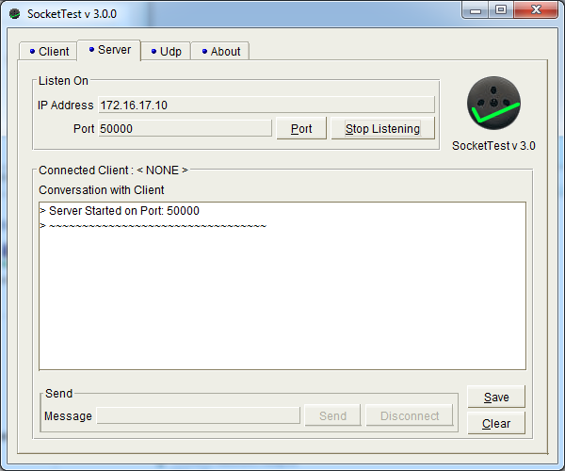
Socket Communication
9
Open SocketTest
Select Server
Define IP-address
Define a port no.
Start listening
IP-address should be same as address on PC
Starting Server
Notes:
Starting Server

Slide 100
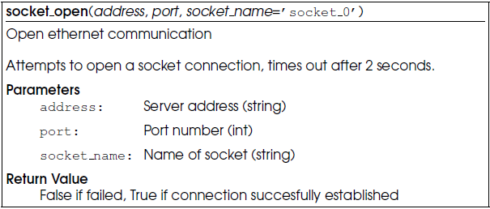
Socket Communication
9
socket_open(address, port, socket_name)
address
port
socket_name
If program opens only one socket, a socket name is not required.
Return value
TRUE if socket opened successfully
FALSE if failed
Open a Socket
Robot Program socket_open(”172.16.17.10”, 50000)
Notes:
Open a Socket

Slide 101
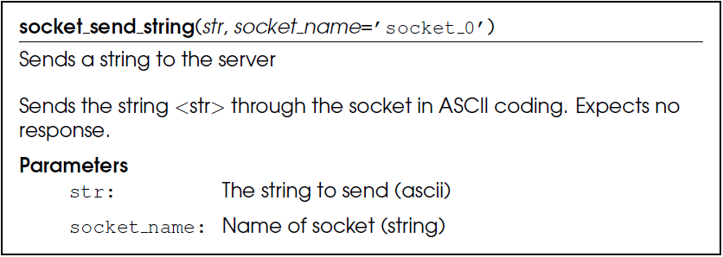
Socket Communication
9
socket_send_string(str, socket_name)
str
socket_name
Return value
none
Send a string
Robot Program socket_send_string(”test”)
Notes:
Send a string

Slide 102
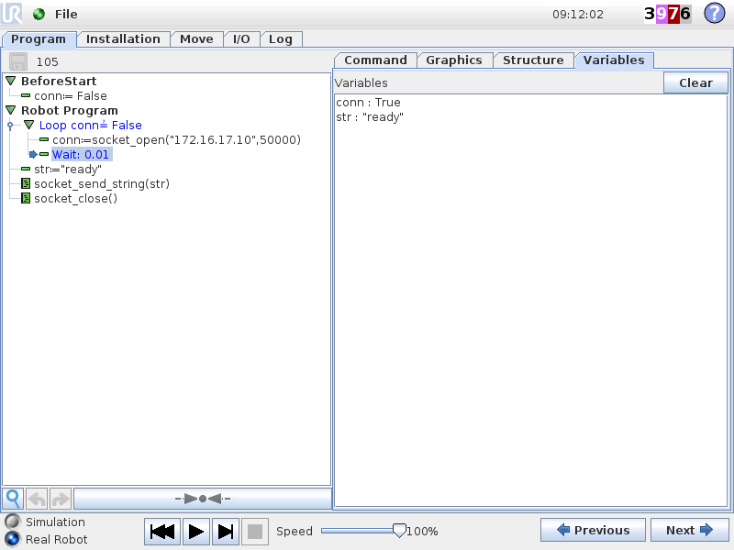
Socket Communication
9
Start Server
Send string to Server
Open socket
Wait until socket is open
Send string
Close socket
Verify result on Server
Sample send string
Notes:
Sample send string

Slide 103
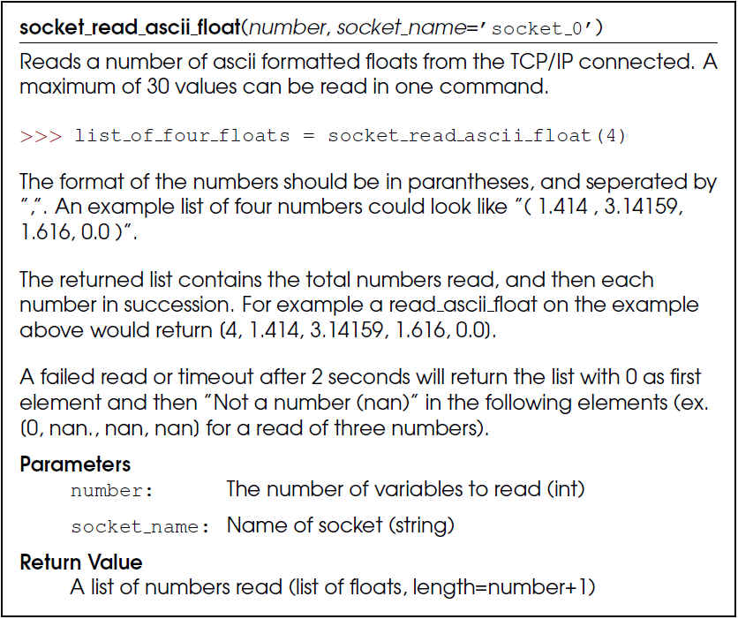
Socket Communication
9
Socket_read_ascii_float (n, socket_name)
number
socket_name
Return value
list of floats + 1 integer
(first number in list is integer and defines amount of valid floats in list)
Receive a response
Robot Program socket_read_ascii_float(3)
Notes:
Receive a response

Slide 104
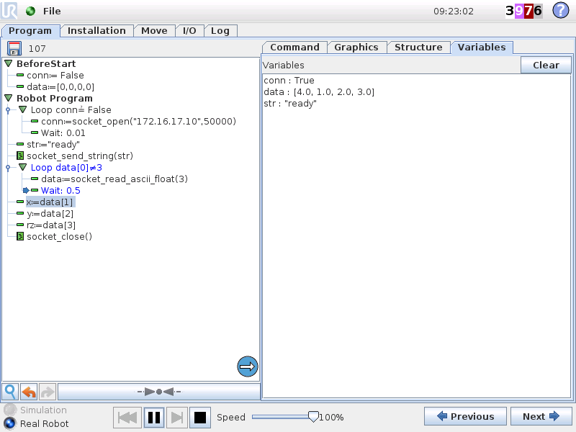
Socket Communication
9
Continue sample
Open socket
Wait until socket is open
Send string
Send request to Server
Read three floats
Wait until three floats received
Save floats in variables *
x
y
rz
Close socket
Server could be a vision camera
Sample Receive a response
Notes:
Sample receive a response

Slide 105
Socket Communication
9
Available data formats
String
Float
Integer
Byte
List
Refer to script manual for full list of socket commands
Working with set_var() and get_var() allows variable name and integer value to be transmitted in a single message.
Data Formats
Notes:
Data formats

Slide 106
Socket Communication
9
Write a program to:
Establish a connection to SocketTest server
Receive two floats over the socket
Add them together
Send the result back to the server.
Wait for another pair of floats
Example:
Server sends: (5,2)
Program returns: 7
Lab Exercise 1
Received = (x, y)
Added = x+y
Return: Added
Notes:
Socket Communications Lab Exercise

Slide 107
Socket Communication
9
Write a program to receive simulated vision coordinates over socket, then move to received position:
Send message to request value over socket then receive three floats
Move to position, based on pose_trans() example from Variables section.
Data Format:
Send string “ready” to server
Read three ascii floats:
x
y
rz
Lab Exercise 2
X
refpoint
RZ
Y
X
BASE
Y
Notes:
Ethernet socket Lab Exercise

Slide 108
Socket Communication
9
Convert your program into a script function:
The script function must: Connect to the camera (server) over socket Send request message Receive movement parameters from camera Convert the data into a position the robot can move directly into. Return the target position
Use the script function in a program, and call the function to get the target data, and move directly there.
Lab Exercise 3
X
refpoint
RZ
Y
X
BASE
Y
Notes:
Ethernet socket Lab Exercise

Slide 109
1
UR Script
6
FTP Server
2
Variables
7
Dashboard Server
3
Features
8
Client Interfaces
4
Advanced use of TCP
9
Socket Communication
Modbus Server
Program Troubleshooting
5
10
Program Troubleshooting
10

Slide 110
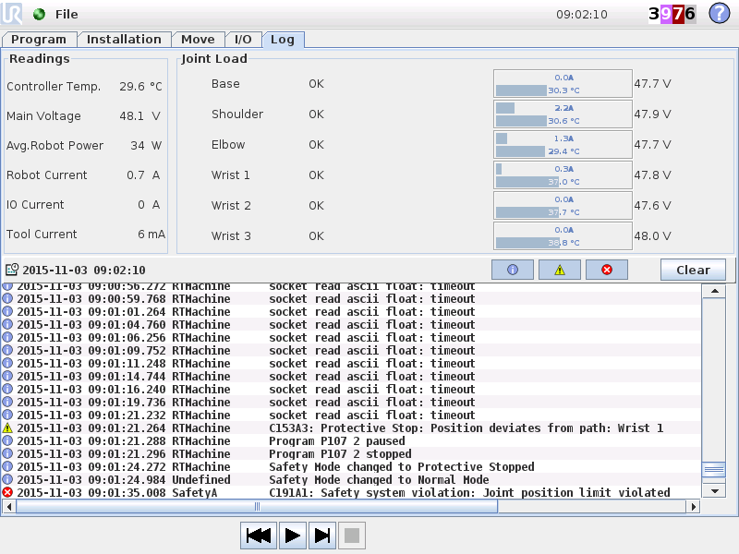
Program Troubleshooting
10
Log history
Contains
Information
Warnings
Errors
Filter with Show/hide
Retrieve log from robot using Magic file or FTP
Log analysis
What does messages mean?
How to improve program structure?
Log file analysis
Notes:
Log history
Log history saves valuable information about robot health and program status
History distinguishes between:
» Information
» Warnings
» Errors
Informations, warnings and errors can be hidden/displayed with the buttons above log window top right

Slide 111
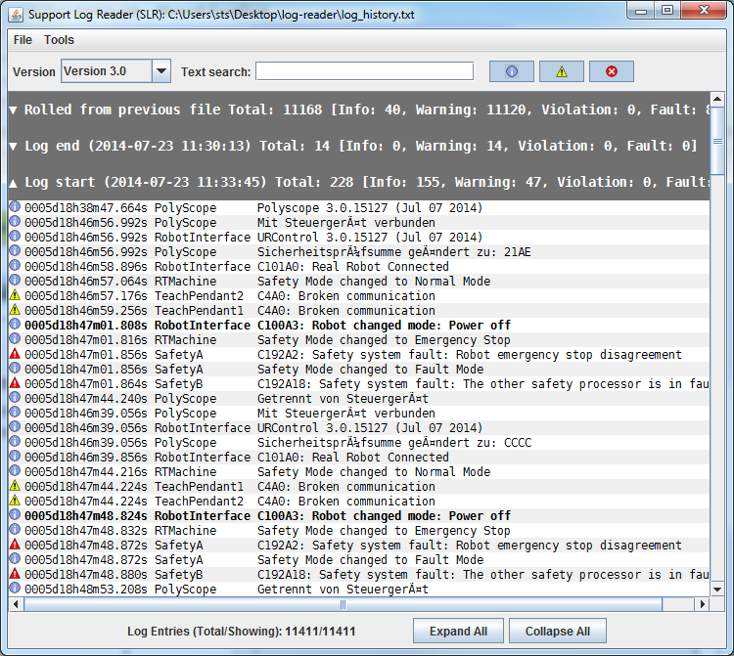
Service
10
Support Log reader
Read log files
Convert language
Export to csv-file
Filter search
Supports
CB3 file format
CB2 file format
Refer to Service Manual for error codes and corrective action
Support Log Reader
Notes:
Log reader
Demonstrate how use UR Log Reader:
1. Download UR Log Reader from support site
2. Install program and open log_history.txt file

Slide 112
Program Troubleshooting
10
Errors related to software
Incorrect/Inconvenient program settings in PolyScope
TCP, Payload, CoG
Accelerations
Blends into e.g. Wait
Fix by:
Correcting program

Slide 113

Program Troubleshooting
10
Wrong payload, TCP or CoG
The robot compensated for the given payload and CoG offset during movements.
If no payload is given, robot will ”feel” external forces due to the tooling → Protective stops
Higher accelerations amplifies the error, thus causes protective stops more often.

Slide 114

Program Troubleshooting
10
Blends into stationary position
Robot maintains speed due to blend on Waypoint_2, but next command forces robot to be stationary for 100 ms.
Protective stop due to ”Sudden Stop”

Slide 115

Program Troubleshooting
10
Motions not ramped down
When IF-statement set to “Check expression continuously”, the robot will stop moving immediately, causing ”Invalid Setpoints: Sudden Stop” error.
Use ”stopj” or ”stopl” to ramp down speed after IF-statement or in ELSE.

Slide 116

Program Troubleshooting
10
Error code
Runtime Error: RuntimeError: Infinite loop detected in program
Cause
If a command is running over and over in a loop without a wait in between
Program will stop
How to fix
Add a short WAIT in any loops
A sync() will also work
Infinite Loop Detected
Notes:
Infinite Loop Detected

Slide 117

Program Troubleshooting
10
Error code
C154A20: Protective Stop: Position in singularity
Cause
Singularity problems surface when trying to control robots in Cartesian space (movel / movep).
A robot singularity occurs when:
robot axes are redundant (more axes than necessary to cause the same motion) or
the robot is in certain configurations that require extremely high joint rates to move at some nominal speed in Cartesian space
How to fix
Use movej() for movements close to singularities
If movement in Cartesion space is required, adjust waypoints accordingly
Modify application layout and adjust waypoints accordingly
Modify end-of-arm tooling by changing angle of the tool direction
Singularities
Notes:
Singularities

Slide 118

Program Troubleshooting
10
Error code
C150A20: Protective Stop: Position close to joint limits
Cause
Indicates that one of the robot joints is at the limit of it’s range
How to fix
Open the Move tab
Check the move joint’s section
If any of the joints are at the end of the range rotate them 360 degrees back to the centre of the range
Re-teach any MoveJ waypoints
Joint Limits
Notes:
Joint Limits

Slide 119

Advanced training
11
You have 30 minutes to answer the questions.
Questions can have multiple answers, so please review all the choices carefully before answering.
Indicate the right answer by ticking or circling the correct choices and filling in the blanks clearly where required.
Feel free to use any material available to you and avoid discussing with other examinees.
Good luck!
Examination
Notes:
Examination

Slide 120

Advanced training
11
Examination Results
1. How do you accommodate for Center of Mass of payload being significantly different from TCP?
Solution :- Use the script function: set_payload()
2. What are the distance and angle units used in UR scripting?
Distance : meters Angle : radians
3. What port number is the Dashboard Server available on?
a. 29999
b. 30000
c. 30001
d. What is the Dashboard Server?
e. None of the above
4. How would you interface an HMI to the robot?
a. Use the Dashboard Server on port 29999
b. Use the secondary client interface on 30002
c. You cannot bypass the Teach Pendant
d. (a) or (b)
e. (b) and (c)
5. The following considerations are important in making a complete risk assessment
a. Degree of possible harm
b. Possibility of avoidance
c. Frequency/duration of exposure
d. How far the robot is from safety fencing & the number of sensors used
e. (a)(b) and (c)
Notes:
Examination

Slide 121
Advanced training
11
6. Which URScript command can be used to read the joint positions in radians?
a. get_actual_tcp_pose()
b. integer_to_binary_list()
c. socket_read_ascii_float()
d. get_actual_joint_positions()
e. None of the above
7. What does the third value in a pose variable correspond to?
a. Y rotation
b. Z rotation
c. Z position
d. X position
e. None of the above
8. What is the reference frame for the pose_add() URScript command?
a. The first pose argument given
b. The base frame
c. The second pose argument given
d. The photo frame
e. None of the above
9. When creating a custom feature, the position of origin of the feature frame is at:
a. The third point in the feature
b. Halfway between the first and second points
c. The first point in the feature
d. The robot base
e. None of the above
Examination Results
Notes:
Examination

Slide 122
Advanced training
11
10. The difference between an installation variable and a program variable is:
a. An installation variable contains all the information about where and how the robot is installed, but a program variable does not.
b. A program variable value is saved between program executions and robot restarts, where as an installation variable is not.
c. An installation variable value is saved between program executions and robot restarts, where as a program variable is not.
d. There is no difference.
e. They are spelt differently.
11. To use the set_tcp() URScript command in a program, you must first:
a. Set the payload to 0.0kg in the installation tab
b. Create a new line feature in the installation tab
c. Set the base feature as variable in the installation tab
d. Move the robot to the home position
e. None of the above.
12. The length of a Modbus register is:
a. 4 bits
b. 1 byte
c. 16 bits
d. 32 bits
e. None of the above
13. The password you need to use to connect to the robot FTP server is:
a. Admin
b. 123456
c. easybot
d. terminator
e. ur
Examination Results
Notes:
Examination

Slide 123
Advanced training
11
14. How many client interfaces are there (not including dashboard server)
a. 5
b. 3
c. 1
d. 18
e. 0
15. When using the socket_open() URScript command, when should you use the socket_name parameter?
a. Always, the command will not work if the socket is not named
b. When there are multiple sockets opened in a single program
c. When the port number is higher than 45000
d. Never
e. When the socket is feeling lonely
16. What action should be taken to deal with the warning “High Measured Force”
a. Check TCP/Payload settings
b. Reduce acceleration parameters in the program
c. Stop, drop and roll
d. Reduce the length of the program
e. (a) and (b)
17. When using socket_read_ascii_float(), the first value in the returned list corresponds to:
a. The first float sent by the server
b. The last float sent by the server
c. The name of the server
d. The number of floats sent by the server
e. None of the above
Examination Results
Notes:
Examination

Slide 124
Advanced training
11
18. In a program, if a variable is first assigned an integer value, then later in the program assigned a string value, what will happen?
a. The program will run without problem, variable types are dynamic
b. A type error will occur, as a variable already defined as an integer cannot be changed to a string.
c. A new thread will be created in the program
d. A second variable will be created containing the string value
e. The variable will become a Stringteger
19. How can position data be transferred from vision camera to robot?
a. Using Ethernet socket communication
b. Using digital I/O’s
c. Using Modbus registers
d. All of the above
e. (a) and (c)
20. Which URscript command(s) is used for calculating the Cartesian distance between two poses?
a. pose_inv()
b. get_target_tcp_pose()
c. pose_sub()
d. pose_dist()
e. All of the above
Examination Results
Notes:
Examination

Slide 125
Change log
14
Date | Revision | Initials | Action | Changes
03/06-2016 | 3.3 | PLN | Changed | Slide 112-115
 |  |  | Changed | Screenshots to 3.3 image

